Slide 1

Yelp Big Data Review
Camille Jackson, Kaysi Castor, Megan Jones, Shatoja Staten, Whyatt Foster
Notes:
Whyatt

Slide 2
Agenda
Goals of Yelp Analysis
Business Findings
Attribute Analysis
Google Cloud AutoML
Next Steps
Notes:
Whyatt

Slide 3
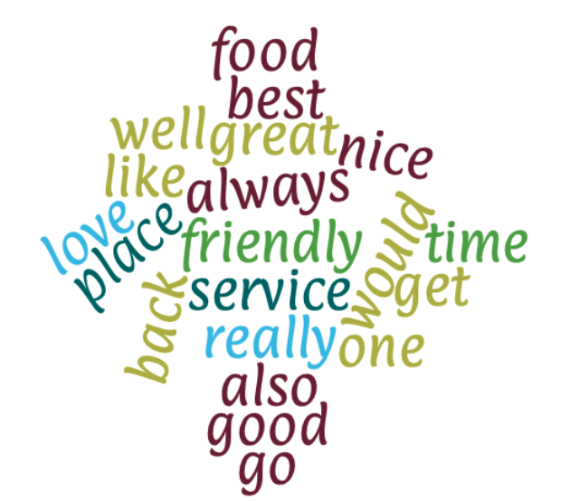

Yelp Reviews Analysis
Highest Rating Review
Lowest Rating Review
Notes:
Camille

Slide 4
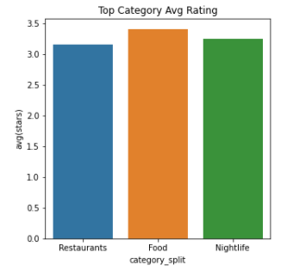
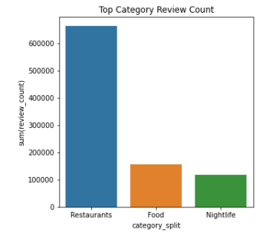
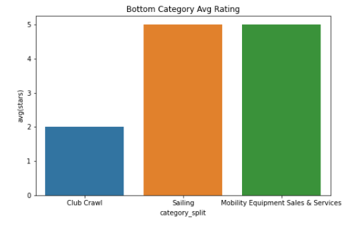
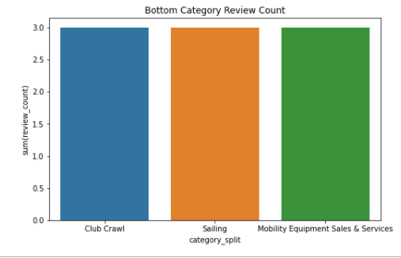
Yelp Business Analysis - Top and Bottom Categories
Notes:
Camille
Yelp Reviews
Word associations among highest and lowest ranked reviews
Yelp Business Attributes & Yelp Business
Top, Middle, and Bottom ranked business by category.
Middle will be explained in paper
Yelp User, Yelp Business
Google Cloud AutoML

Slide 5
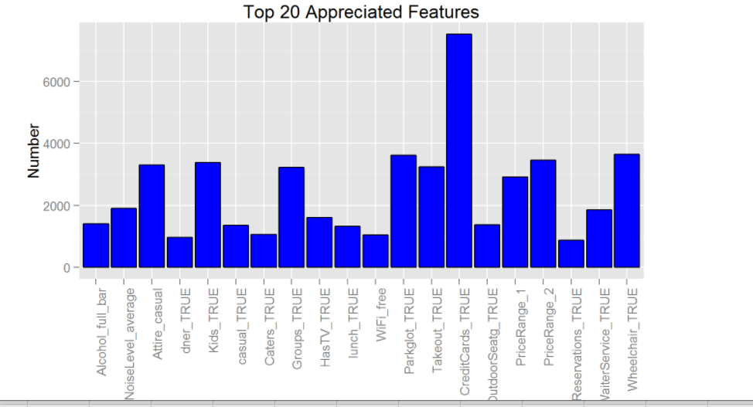
Yelp Business Analysis
Notes:
Shatoja

Slide 6
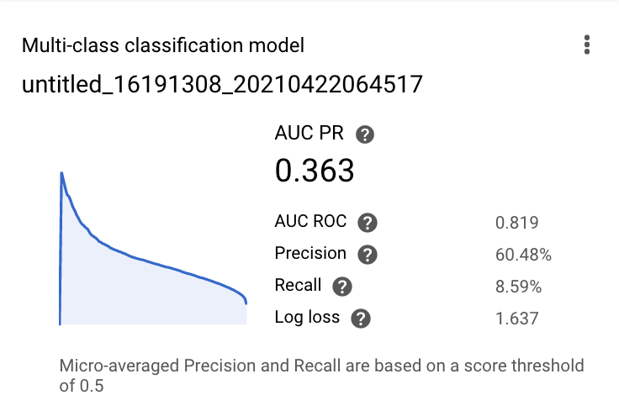
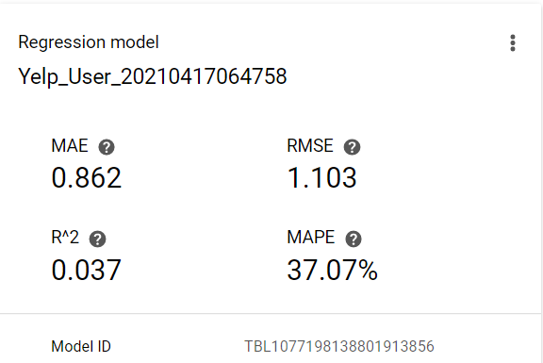
Yelp User AutoML
Business Review – Target Stars
User – Target Average Stars
Notes:
Megan
For User dataset there isn’t a strong connection between our independent and dependent variable. Suggest Yelp focus on connecting users with platforms for more than extreme experiences.

Slide 7
Next Steps & Recommendation
Refactor Models to Key Indicators
Update Cloud Model for Real-Time Streaming
Continuous Improvement to Increase Market Share for Low Performing Categories
Complete Feature Analysis by Category
Questions
Notes:
Kaysi

